Slide 1
Welcome to the COS132 Crash Course
By Werner Mostert

Slide 2
Code Examples and Slides
All the examples that will be discussed, available here:
https://github.com/WMostert1/COS132-Crash-Course
How do I get the code?
It’s easy! Go the link above, click on “Clone in Desktop” to clone the repository. Just sync to get new code.
Other option, click on “Download ZIP” to download the archive
Let’s get started!

Slide 3
Data Types
C++ is a “strongly typed” programming language. What does it mean if a language is strongly typed?
What is the difference between data types?
Size of data type
Representation inside the computer
See dt.cpp

Slide 4
Data Types Cont.
The compiler needs to know the Data Type before it executes the program
Strongly Typed means that when you try and code :
x = 1
A compilation Error will occur, if not defined earlier
int x = 1
That’s fine, since now the compiler knows what to do with the value assigned to it

Slide 5
Data Types Cont.
Size of Data Types
Each data type has a certain size associated with it
This size is used to determine how much space it “takes up” in memory
Imagine memory as a finite 3-D space.
Each variable takes up a part of this space
The amount of space it occupies is determined by the data type
Two spaces can never be the same

Slide 6
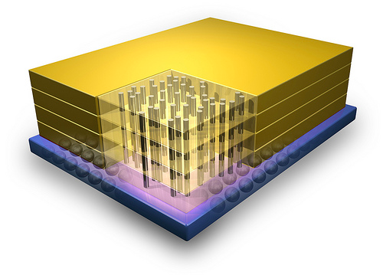
Data Types Cont.

Slide 7
Data Types Cont.
Representation
As I am sure you know, at the very lowest level, all data is represented by sequences of binary digits.
That is, all data types are in a sense the same thing. They are just used differently.
For interest sake:
We use the decimal system (base 10)
The binary system is base 2
Hexadecimal is base 16 (normally represented with a 0X prefix)

Slide 8
Pointers
Pointers in C++ can become very complex, and quite literally an interconnected maize of references. Be careful with them! Treat them with care and they won’t kill your program.
What are pointers?
Why do we need pointers?
How do I use pointers?
The good news and the bad news

Slide 9
Pointers Cont.
What are pointers?
Remember the finite 3D space where we put our variables in earlier? (i.e. memory)
A pointer is yet another data type
A pointer is simply a “reference”
What is meant by “reference”?
A reference is something that tells you where to find “something” in the 3D space
Since a pointer is just a reference, all pointers have the same size. See ArrayDT.cpp

Slide 10
Pointers Cont.
Why do we need pointers?
Its simple. If we don’t know where something is in the vastly large 3D-space it gets lost and stays there for all eternity (or at least until your computer shuts down) or it is replaced. Depending on where in memory it is located.
We basically just don’t know where to get our variables
Pointers are very useful for Complex Data Types (classes). More about Pointers in COS 110.

Slide 11
Pointers
How do I use pointers?
If assigning a value to a pointer which is not an address. Use the keyword new
Example: P.cpp
Remember the difference between a reference and an actual piece of data

Slide 12
Pointer Cont.
Good news:
That’s almost it for pointers! If you understand this part, the next part of using them should be very easy.
Bad news:
If you are continuing on with COS 110 and COS 121, be prepared. Be very prepared.

Slide 13
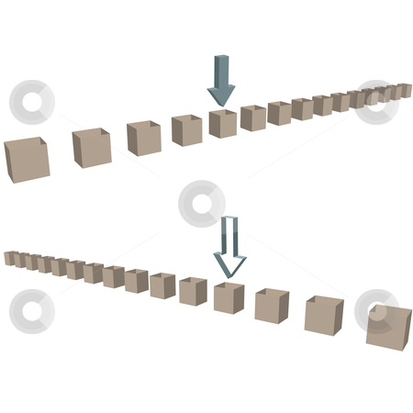
Arrays as Data Types
What is an Array?
How do you use an Array?

Slide 14
Arrays Cont.
An array is literally a collection of variables
They are linearly ordered in memory
Think of a row of boxes tightly fitted next to each other. The dimensions of the box are determined by the data type it needs to hold.
Now take that row of boxes and put them in that massive finite 3D-space called memory.
Great! Now we have an array of variables

Slide 15
Arrays Cont.
How to use an array:
Example : See A.cpp
Access an element in an array [ ]
Define an an array as:
dataType variableName[size];
What happens when you use the array name without [ ]?

Slide 16
Arrays as Pointers
An array is a pointer! WHAAAAT!?
An array is just a special kind of pointer.
Just declare it as follows and use it in the same way as normal arrays:
dataType* variableName = new dataType[10]
Remember not to put * again on the second dataType
Why? Look in PA.cpp

Slide 17
Let’s take a breather…
Ok, so by now we have covered:
Data Types,
Pointers,
Arrays,
Arrays as Pointers
Any questions?
Now let’s have a look at functions and the layout of a program

Slide 18
Functions
What is a function?
Similarity with mathematical functions
Why do we use functions?
How to implement a function
How to call a function

Slide 19
Functions Cont.
What is a function?
Functions have a lot of different names, amongst others:
Procedure
Sub Procedure
Sub Function
Sub
Method
Sub Routine
Etc…

Slide 20
Functions Cont.
The goal of a function is to “do” something.
If you think of any action. Any action could be a function, examples:
To kick a dog:
Void kickThatDog(){…you kick the dog…}
To feel horrible for kicking a dog:
Void feelHorrible(){…you cry…}
Pay the vet money to help the dog:
Double payMoneyToVet(double money){..hand over money… return change;}

Slide 21
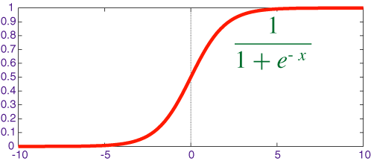
Functions Cont.
In mathematics one also uses functions:
In C++: See sigmoid.cpp

Slide 22
Functions Cont.
For all the actuaries present, the usefulness of functions should now become rather apparent
The only reason we use “functions” is for code re-use and modularity
The sigmoid function is a rather simple example, it could however be strenuous to type it out every time you want to calculate the sigmoid value. To illustrate this point further :

Slide 23
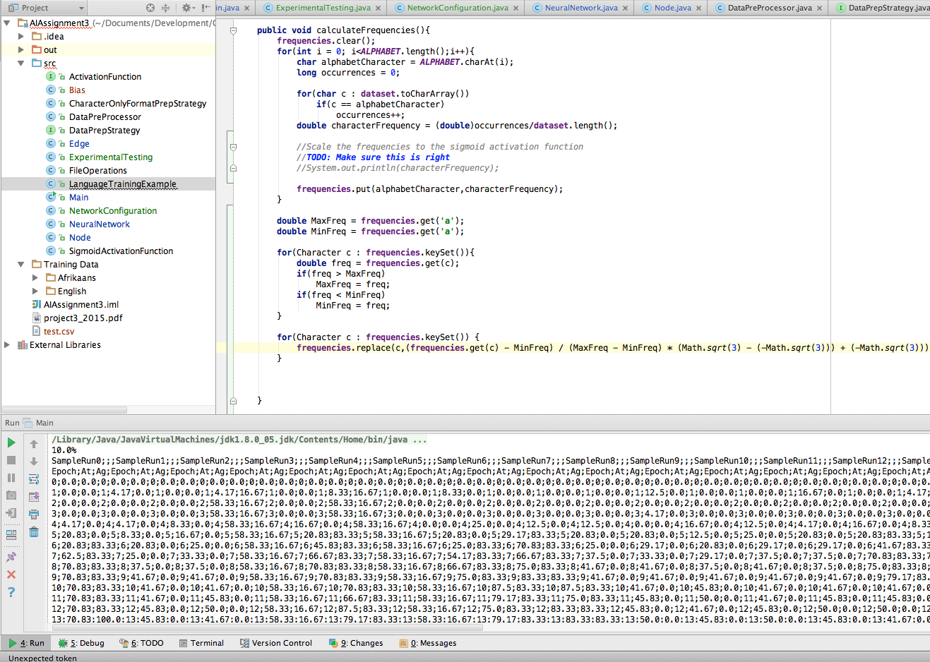

Slide 24
Functions Cont.
The screenshot on the previous slide shows a function to calculate the frequency of alphabet characters in a text file with thousands of words in it
You definitely don’t want to re-write all that every time

Slide 25
Functions Cont.
How to implement a function?
Start with the prototype
General formula for a prototype:
returnType functionName(paramater)
returnType can be either a dataType or void
Paramater is optional, but there can be more than one of them
Paramater denotes : dataType variableName

Slide 26
Functions Cont
What is a prototype?
Think of a prototype as a promise you make to the computer.
The name of the function (as specified in the prototype) identifies the promise
The parameters are what is needed for the promise to be fulfilled
The return type is what you get back after you fulfilled the promise

Slide 27
Functions Cont.
In the real world, when you make a promise you only need to fulfill that promise once the person you made it to asks you to fulfill it or you decide to do it by yourself.
When stating the promise (defining the function), you use { and } to say, the content between { and } is what will happen when the promise is fulfilled. That is, the function is called.
( and ) are used to specify the parameters (preconditions to the promise being fulfilled).

Slide 28
Functions Cont.
Back to a more technical view, by declaring a prototype you tell the compiler that there exists a function identified by the function name.
To call the function, you use the function name together with the () with optional parameters separated by a set of “ , ”.
One needs to implement a function at some time though. If a function isn’t implemented and the compiler was promised that function, a compiler error will occur.

Slide 29
Functions Cont.
Phew. That was quite a bit. Let’s look at some code:
Example: Func.cpp
By now you should know, there are MANY different ways of implementing functions.

Slide 30
Program Layout
A quick word on where to implement your functions.
.h files are called “Header files”, these normally contain all the prototypes (and later on, class definitions)
.cpp files are called implementation files, and should contain the implementation of the prototypes
Any C++ program needs at least one .cpp file with a int main(){…some code… return someInt;}
This is called the program’s entry point

Slide 31
Program Layout
In order to better understand the layout, think of #include as simply saying, take the file and copy it, then highlight me and paste.
Examples:
Main.cpp
Foo.cpp
Foo.h
Remember to compile all the .cpp’s, what happens if you don’t?

Slide 32
Tips for Fitch Fork
Why do I get a -1?
-1 means that an ERROR occurred. You get two types of errors:
Compiler Errors: There is a problem with your C++ syntax
Runtime Errors: Something bad happened while running. Ever seen SEGMENTATION FUALT? Remember pointers?
My program works on my computer, why not on Fitch Fork?
Fitch Fork is a computer. It does a comparison,
If(yourOutput = myOuput) then youGetMarks();
Beloved Fitch Fork check every single character, even ones you can’t see, like \0 \n \t “ “ etc.

Slide 33
Conclusion
Thank you for attending!
If there are any questions, please ask them now.

